Slide 1
I B PATEL ENGLISH SCHOOL
(PRIMARY SECTION)
CLASS – 1
SUBJECT – ENGLISH GRAMMAR
CHAPTER – 1
FUN WITH LETTERS

Slide 2
CAPITAL LETTERS
SMALL LETTERS
A
APPLE
a
apple
B
BOOK
b
book
C
CAT
c
cat
D
DOOR
d
door
E
EGG
e
egg

Slide 3
CAPITAL LETTERS
SMALL LETTERS
F
FISH
f
fish
G
GRAPES
g
grapes
H
HUT
h
hut
I
ICE
i
ice
J
JAM
j
jam

Slide 4
CAPITAL LETTERS
SMALL LETTERS
K
KITE
k
kite
L
LEAF
l
leaf
M
MOON
m
moon
N
NEST
n
nest
O
ONION
o
onion

Slide 5
CAPITAL LETTERS
SMALL LETTERS
P
PAN
p
pan
Q
QUEEN
q
queen
R
RAT
r
rat
S
SUN
s
sun
T
TAP
t
tap

Slide 6
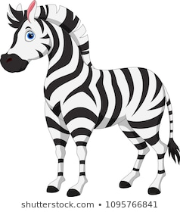
CAPITAL LETTERS
SMALL LETTERS
U
UMBRELLA
u
umbrella
V
VAN
v
van
W
WELL
w
well
X
XMAS TREE
x
xmas tree
Y
YAK
y
yak
Z
ZEBRA
z
zebra

