Slide 1
I B PATEL ENGLISH SCHOOL
(PRIMARY SECTION)
CLASS – 1
SUBJECT - ENGLISH
CHAPTER – 1
A HAPPY CHILD

Slide 2
Let’s learn some words from this lesson.
child
happy

Slide 3
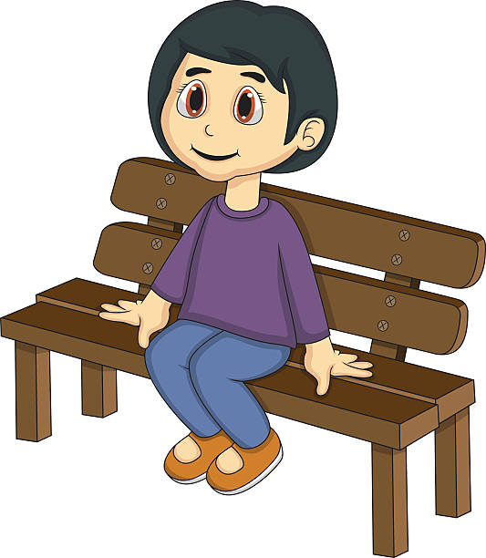
red
house
red

Slide 4
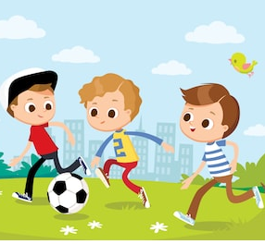
laugh
play
cry

Slide 5
tree
green
sun

Slide 6
SMALL LETTERS
CAPITAL LETTERS
drum
DRUM
ship
SHIP
child
CHILD
desk
DESK
pot
POT
toy
TOY

Slide 7
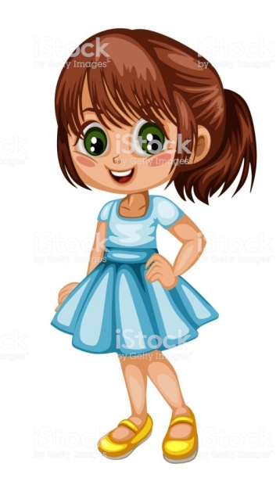
I am a girl.
I am a boy.
She is a girl.
He is a boy.

Slide 8
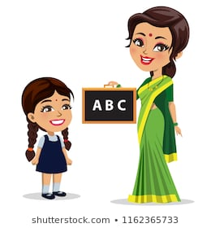
You are a teacher.
It is a cat.

Slide 9
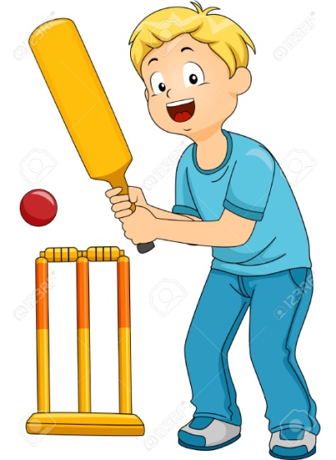
This is my book.
That is your bat.

Slide 10
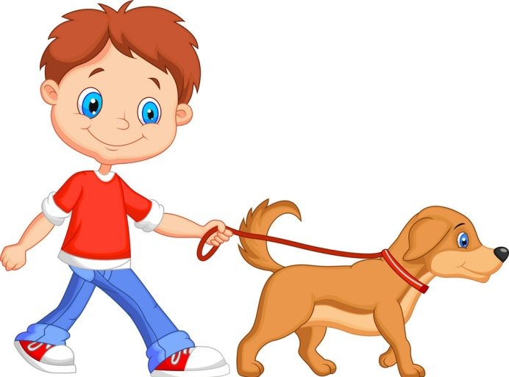
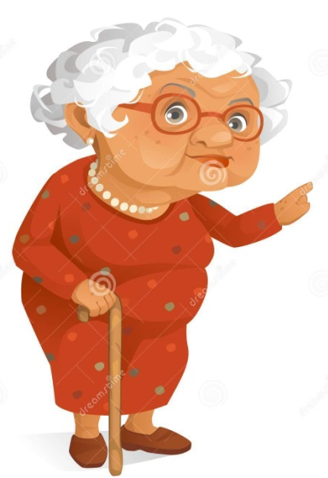
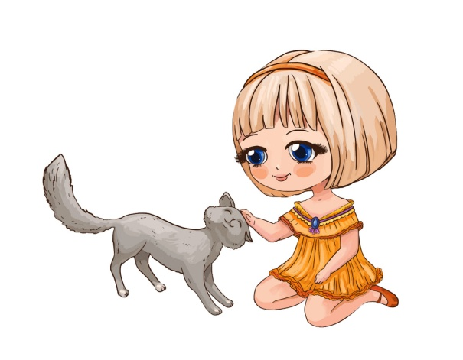
That is his dog.
That is her cat.

