Slide 3
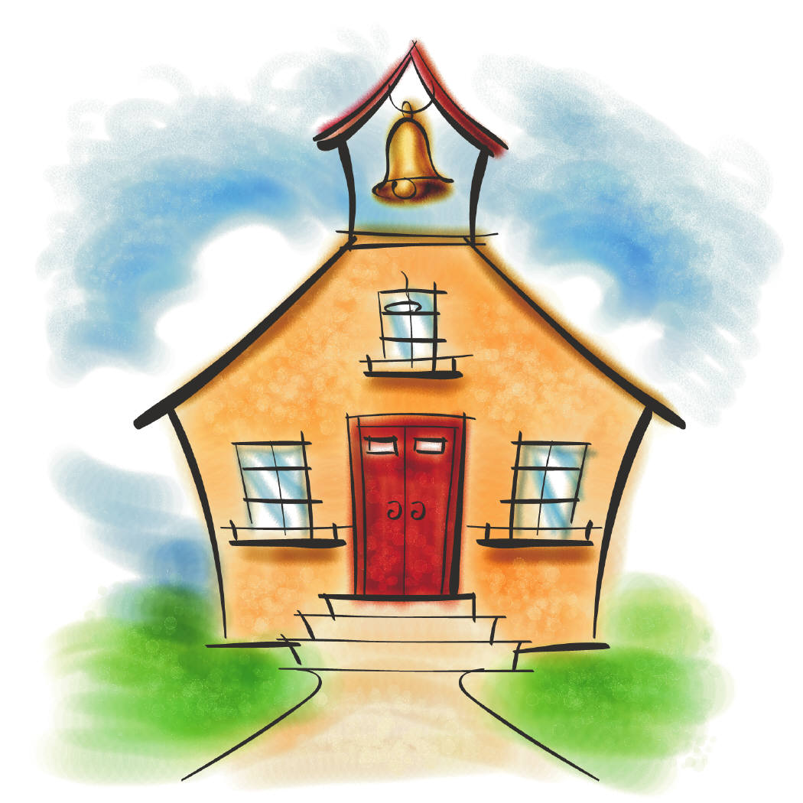
First Day of School

Slide 4
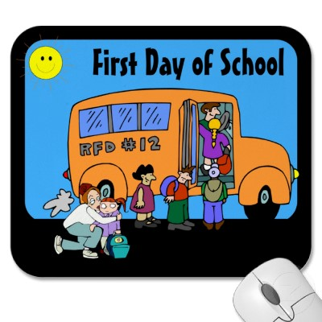

Slide 7
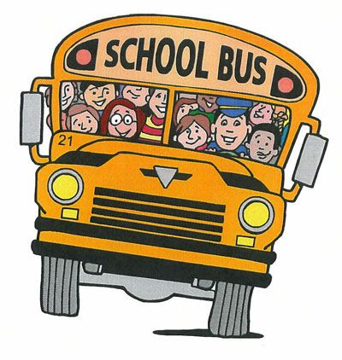

Slide 8
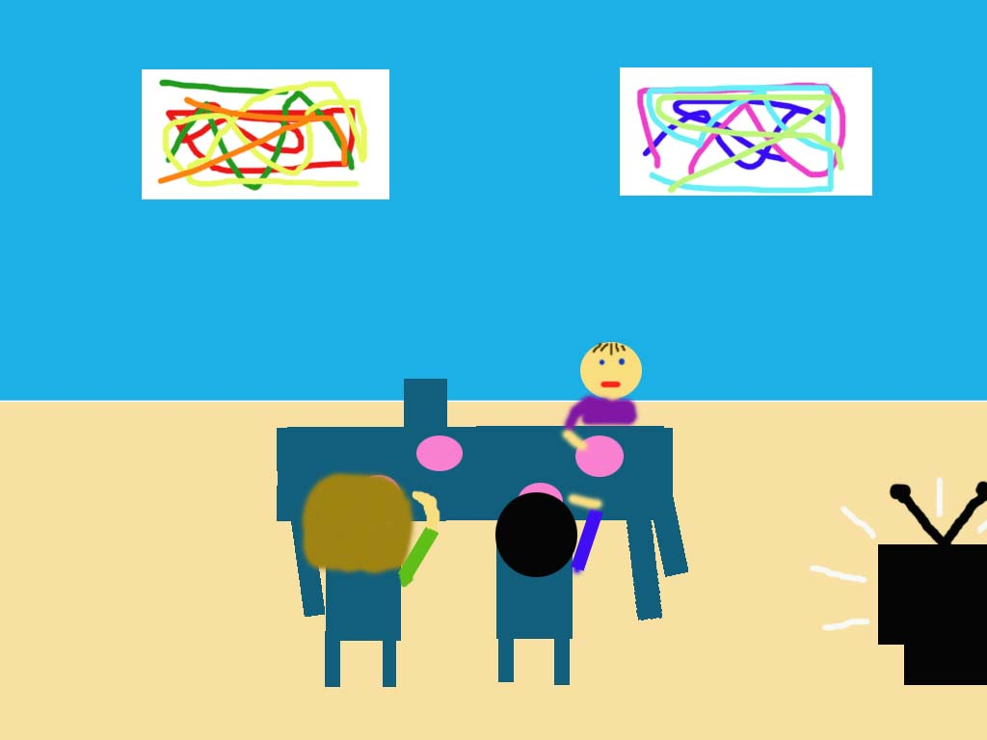
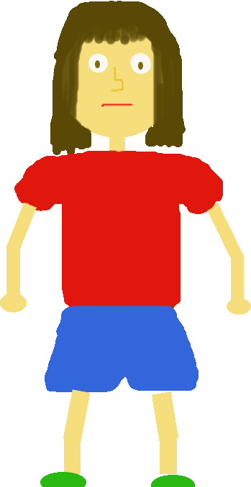
Allison, are you excited for your first day of school?

Slide 9
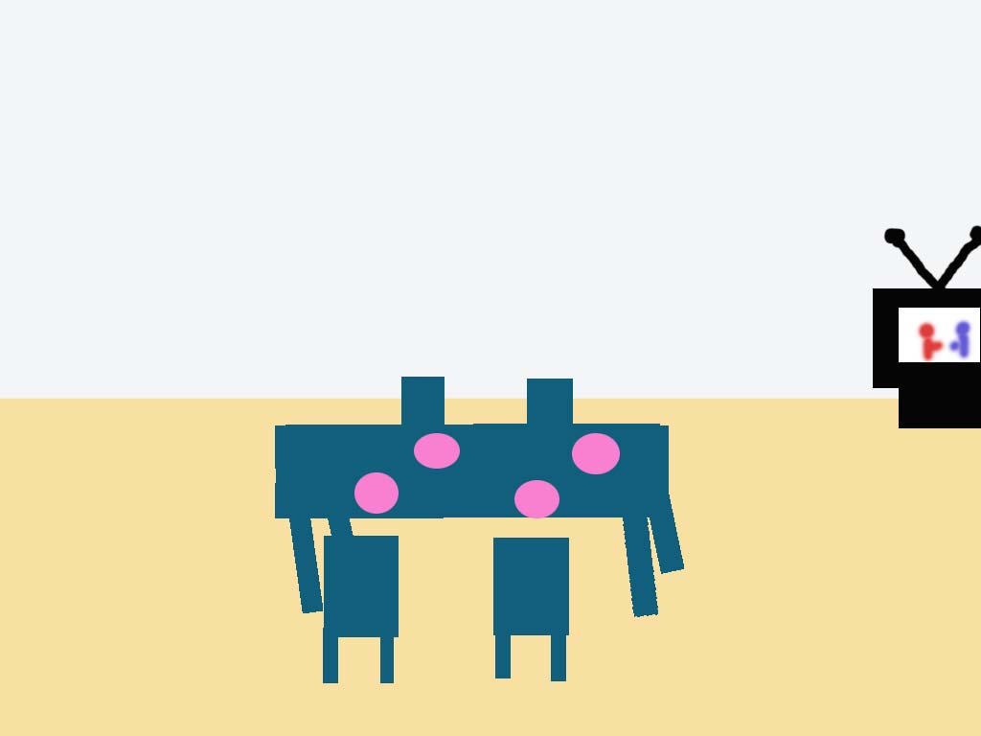
Allison, are you going to answer your mother?
Jon turn down the T.V.

Slide 10
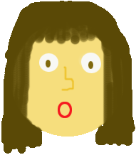
Oh, sorry! I didn’t know you were talking to me. What did you say?

Slide 11
Are you feeling alright Allison? You haven’t touched your breakfast.
You guys are going to be late for school. Go get ready!

Slide 12
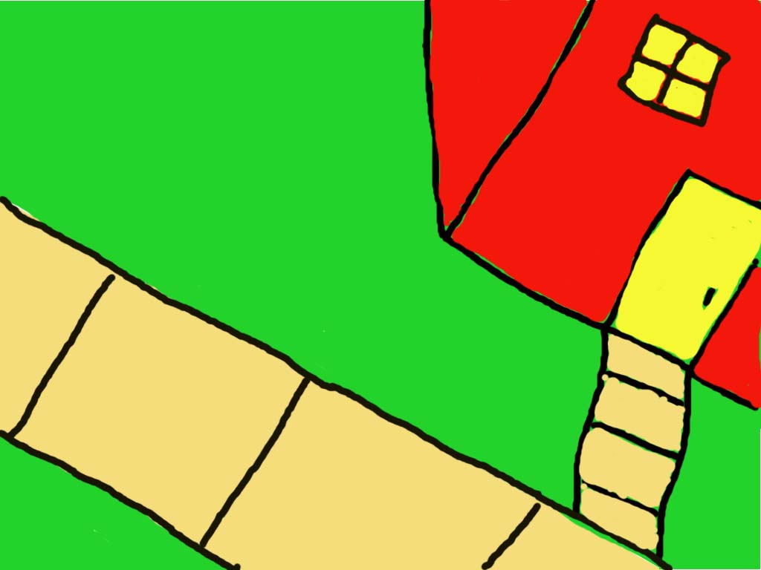
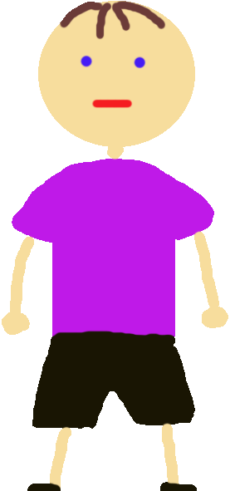
No body is going to like me. I am going to have no friends.
Come on Allison, hurry up!

Slide 13
Hi! My name is Mrs. Smith! I will be your teacher this year. What is your name?
Blocks
Sand
House
My name is Allison.
Well we are about to start class. Why don’t you go take your seat.

Slide 14
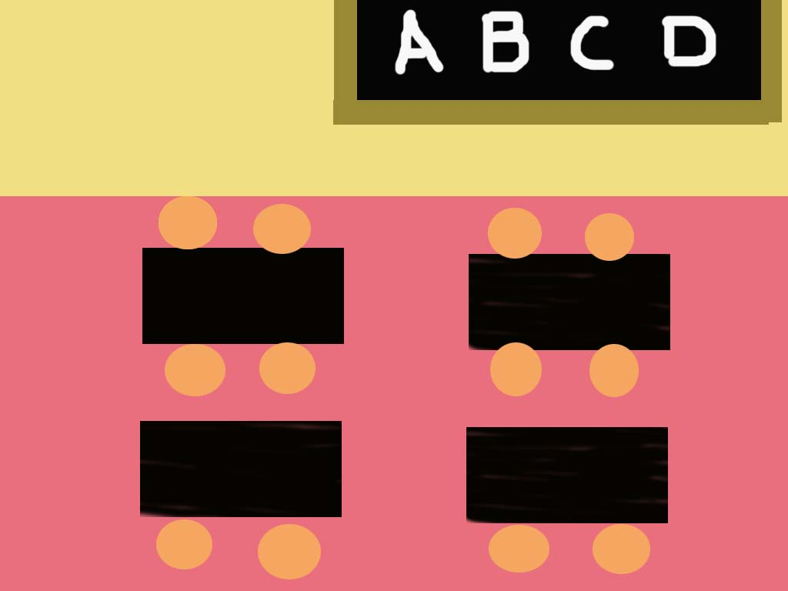
Welcome students! I hope you are all excited to start kindergarten.
Now I want you to see what color you are and look on the poster to see what activity you should go to first.

Slide 15
Blocks
Sand
I am yellow. I guess I am suppose to go to the blocks.
House
Computer

Slide 16
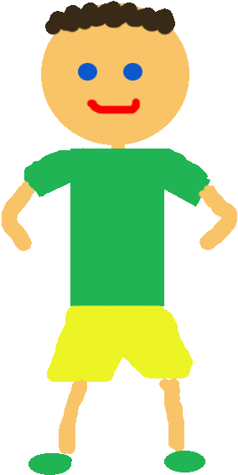
Hi! Can I play with you? My name is Scott.
Sure. I am Allison.

Slide 17
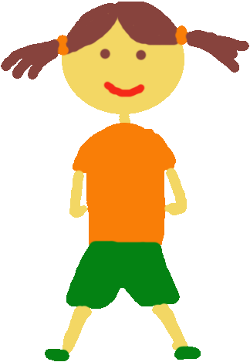
Sure, I am Allison and this is Scott.
Can we play too?
I am Kim and this is Lisa. Thanks for letting us play with you!

Slide 18
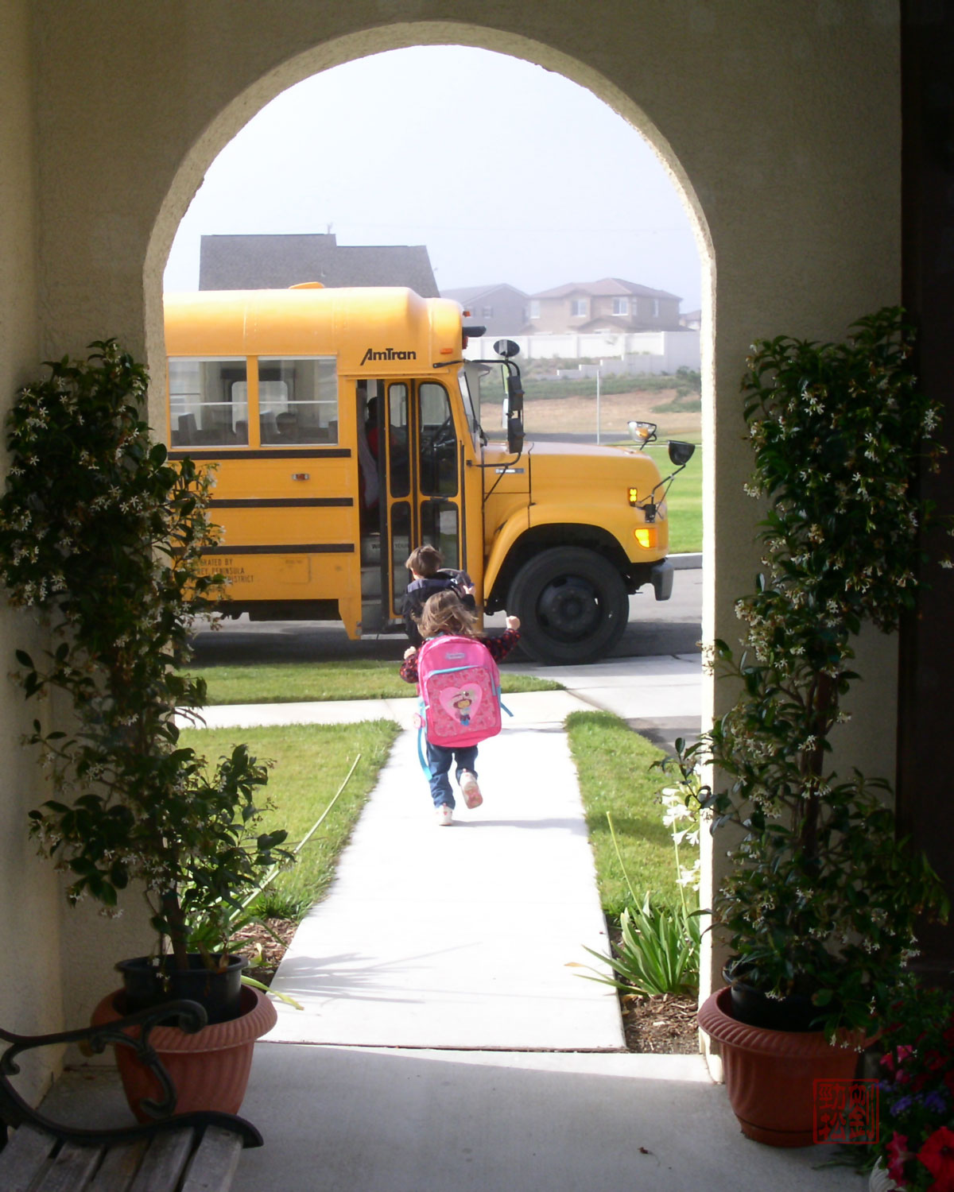

Slide 19
Mom, I am so excited! I made so many friends today. Kindergarten is awesome!
Well someone seems to be in a much better mood.

