Slide 1
I B PATEL ENGLISH SCHOOL (PRIMARY SECTION)
CLASS - 3
SUBJECT- EVS
CHAPTER- 1
WHAT DID POONAM SEE?

Slide 2
Poonam see
Animals lives in different places
Some animals live on the tress
Some in water
Some live on land
Some live under the ground
Some fly in the sky.

Slide 3
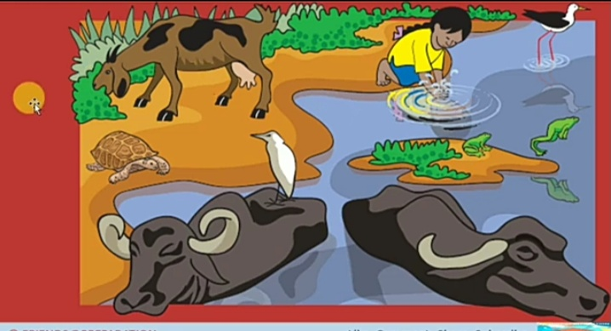

Slide 4
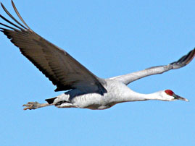
Animals we find on branches

Slide 5
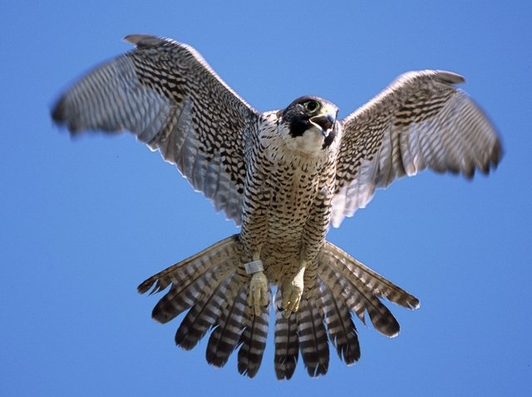

Slide 6
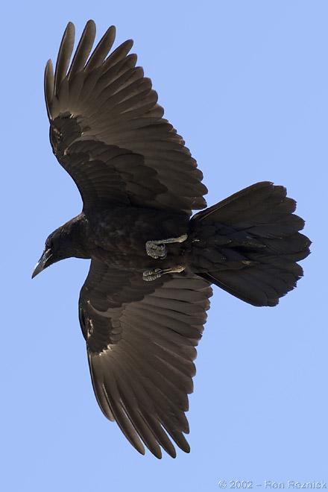

Slide 7
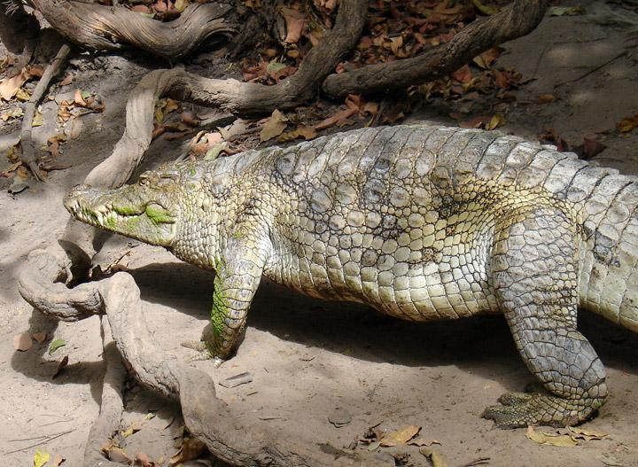
Animals that can crawl

Slide 8
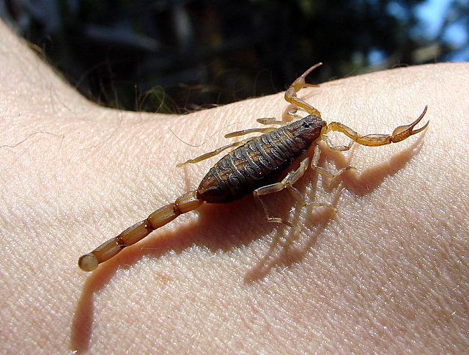

Slide 9
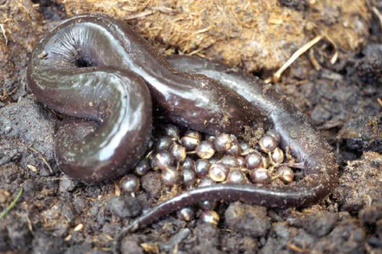

Slide 10
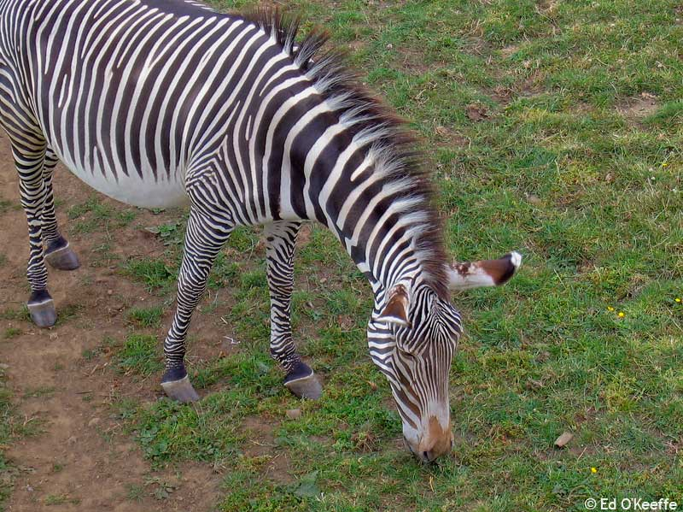
Animals that can walk

Slide 11
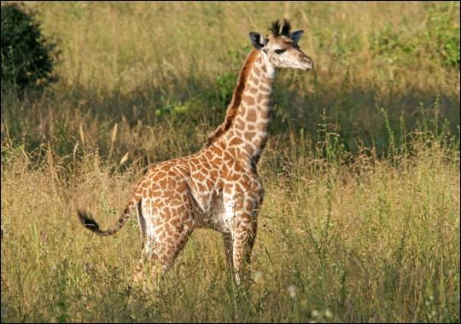

Slide 12
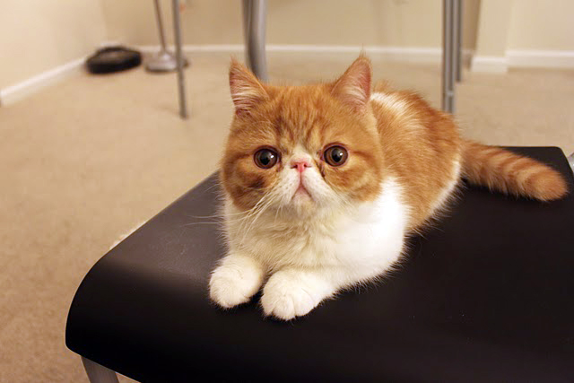

Slide 13
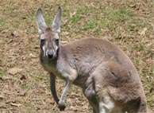
Animals that can hop

Slide 15
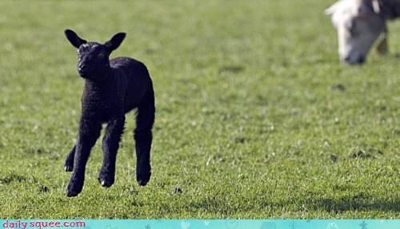

Slide 16
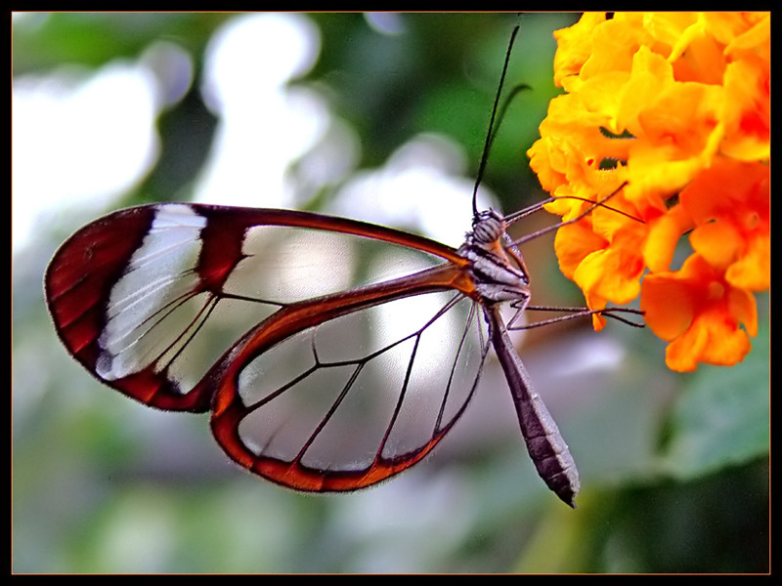
Animals that have wings

Slide 17
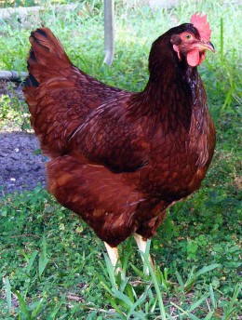

Slide 18
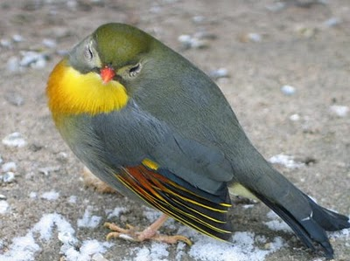

Slide 19
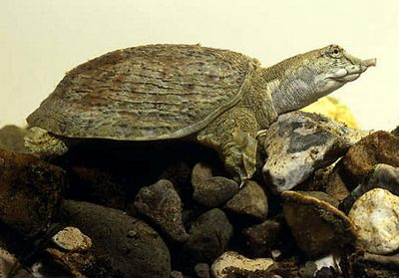
Animals that have feet

Slide 20
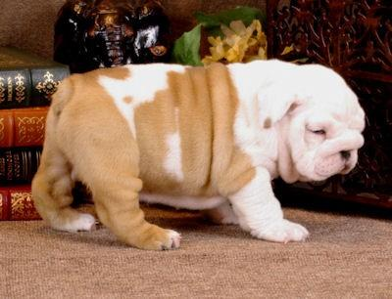

Slide 21
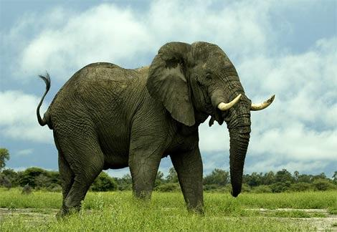

Slide 22
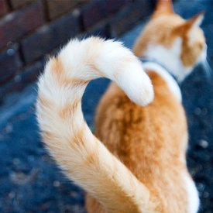
Animals that have tails

Slide 23
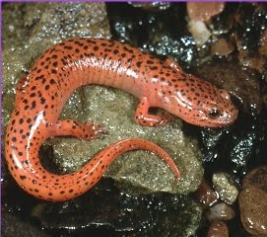

Slide 24
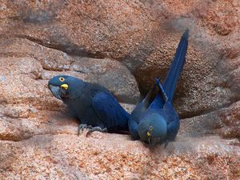
Animals that live on the leaves

Slide 25
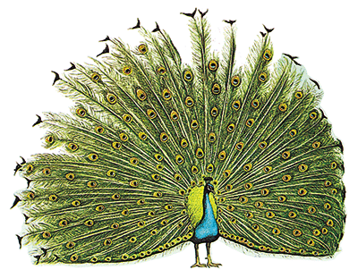

Slide 26
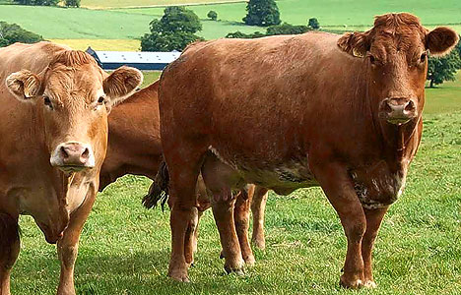
Animals that live on the ground

Slide 27
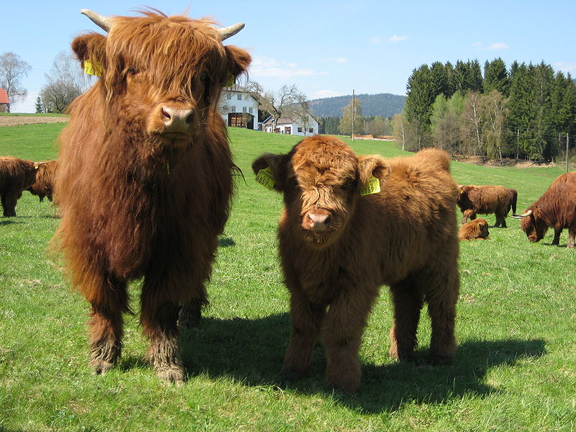

Slide 28
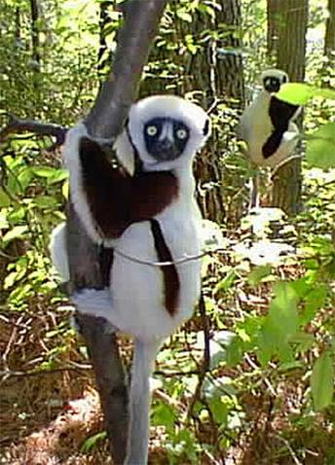
Animals that live around the tree

Slide 29
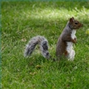

Slide 30
EVALUATION
CAN YOU DRAW THIS ANIMAL WITH THUMB PRINTING ?
NAME THE ANIMAL TOO

Slide 31
DRAW THIS ANIMAL AND NAME IT

Slide 32
TELL FEW ANIM ALS WE FIND IN OUR HOMES

Slide 33
CAN YOU TELL SOME UNINVITED ANIMALS IN OUR HOMES

