Slide 1

I B PATEL ENGLISH SCHOOL
(PRIMARY SECTION)
CLASS – 7
SUBJECT - ENGLISH
CHAPTER – 1
THREE QUESTIONS

Slide 2
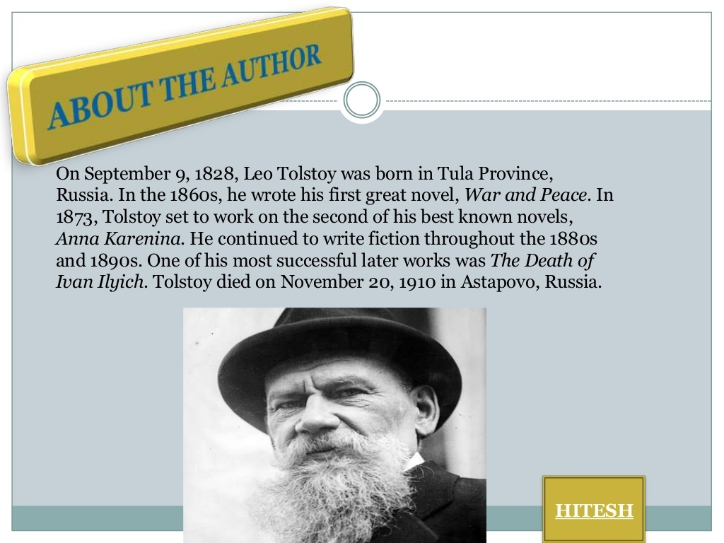

Slide 3
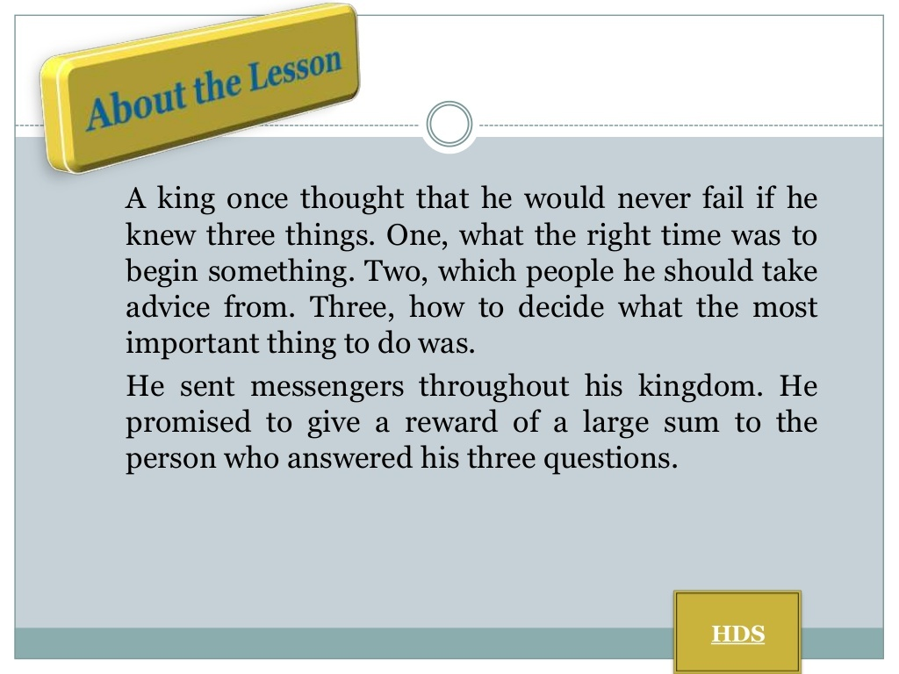

Slide 4
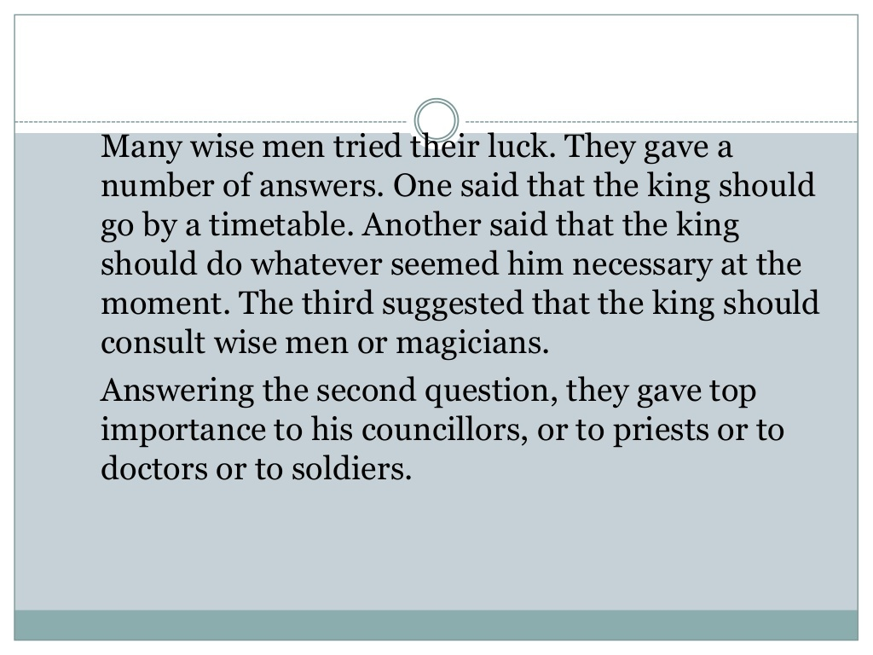

Slide 5
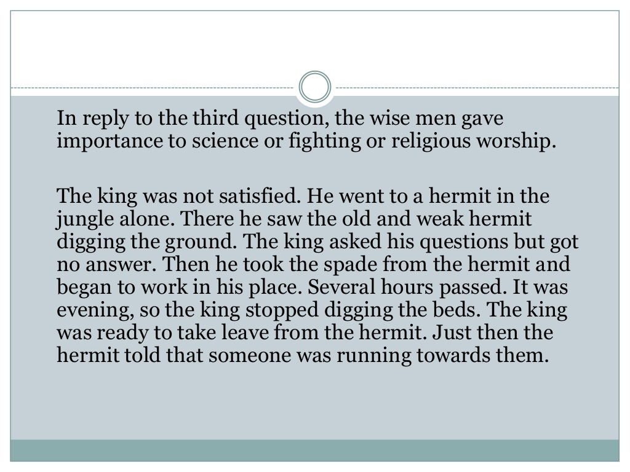

Slide 6
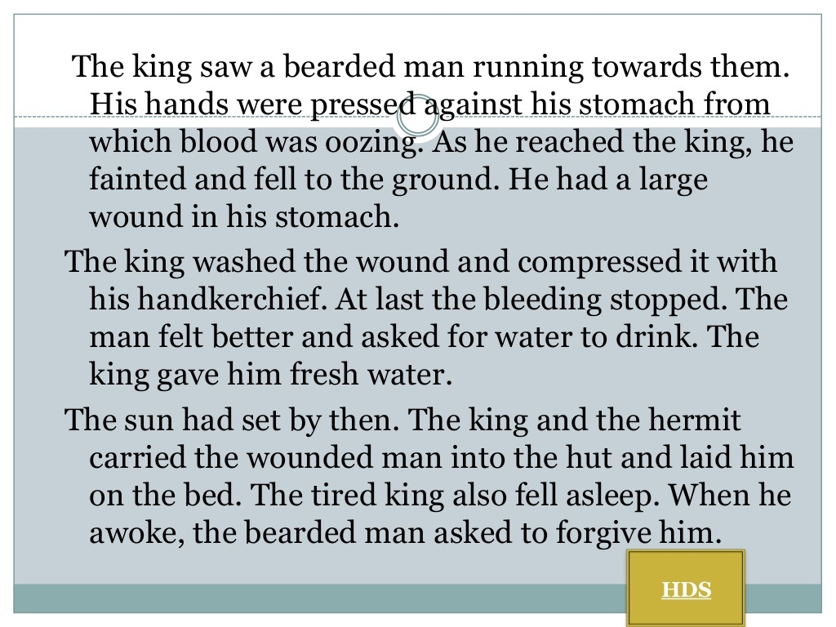

Slide 7
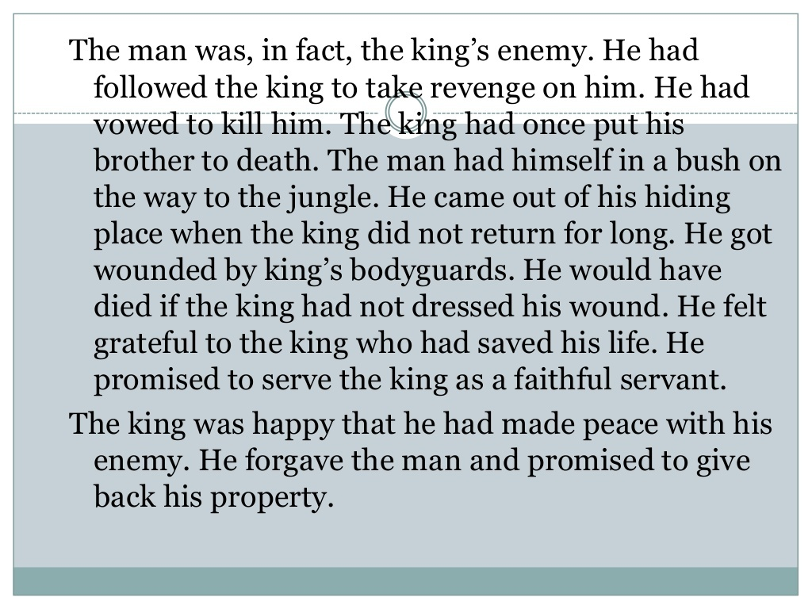

Slide 8
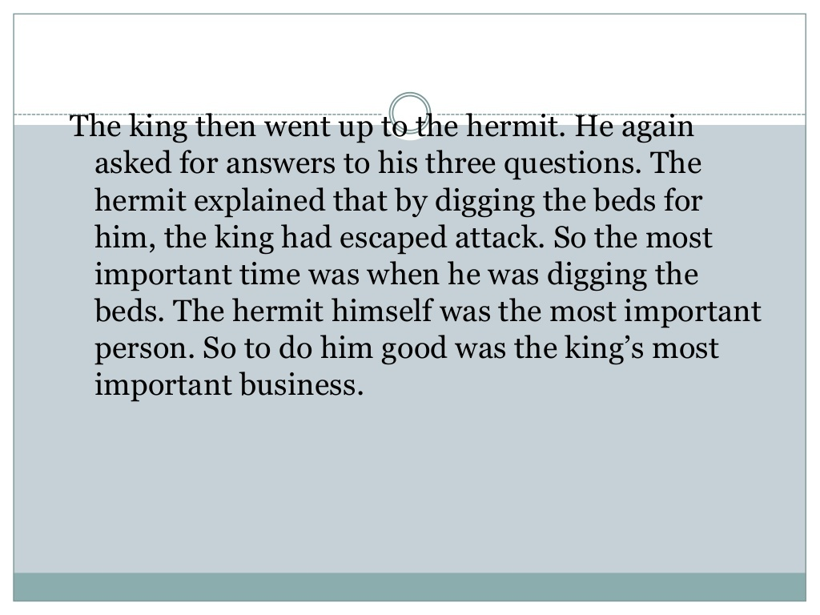

Slide 9
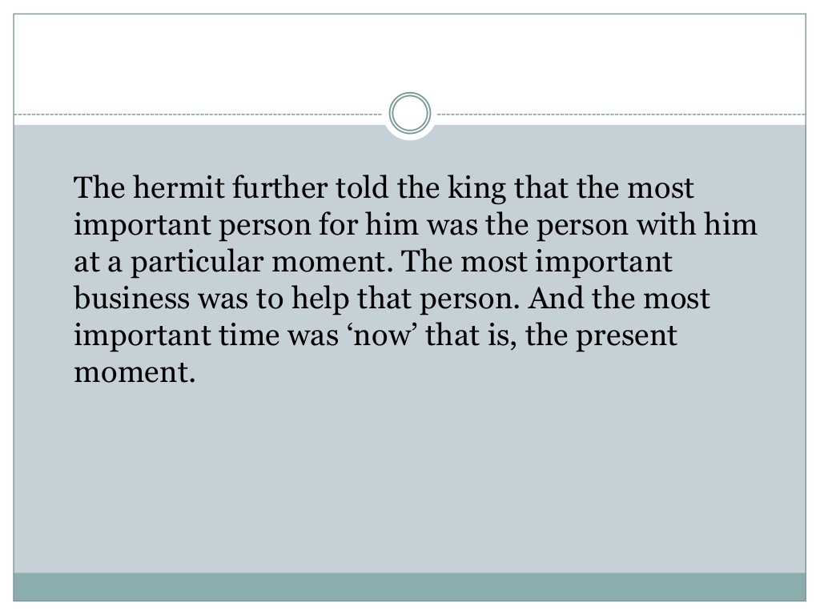

Slide 10


